Slide 1
Relational Calculus
courtesy of Joe Hellerstein for some slides
Jianlin Feng
School of Software
SUN YAT-SEN UNIVERSITY

Slide 2
Relational Calculus
Tuple Relational Calculus (TRC)
  Variables in TRC take on tuples as values.
Domain Relational Calculus (DRC)
  Variables in DRC range over field values.

Slide 3
Tuple Relational Calculus
Query has the form: {T | p(T)}
  T is a tuple variable.
  p(T) is a formula containing T .
Answer to the Query = the set of all tuples t for which p(T = t) = true.

Slide 4



Syntax of TRC Queries
Atomic formula:
  T ∈ Relation
  T.a op T.b
  T.a op constant
    … op is one of
A formula can be:
  an atomic formula
  , where R is a tuple variable
  , where R is a tuple variable

Slide 5
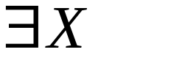
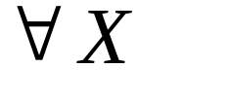
Free and Bound Variables
Quantifiers: ∃ and ∀
Use of or binds X.
  A variable that is not bound is free.
Recall our definition of a query:
  {T | p(T)}
Important restriction:
  T must be the only free variable in p(T).
  all other variables must be bound using a quantifier.

Slide 6
Some Notations
∃T ∈Relation(p(T)) represents
  ∃T (T∈Relation ∧ (p(T))
∀ T ∈Relation(p(T)) represents
  ∀ T (T∈Relation ⇒ (p(T))

Slide 7
Simple Queries
Find all sailors with rating above 7
Find names and ages of sailors with rating above 7.
  Note: S is a variable of 2 fields (i.e. S is a projection of Sailors)
{S |S ∈Sailors ∧ S.rating > 7}
{S | ∃S1 ∈Sailors(S1.rating > 7
∧ S.sname = S1.sname
∧ S.age = S1.age)}

Slide 8
Joins
Find sailors with rating above 7 who have reserved boat #103
{ S | S∈Sailors ∧ S.rating > 7 ∧
∃R(R∈Reserves ∧ R.sid = S.sid
∧ R.bid = 103) }

Slide 9
Joins (continued)
Find sailors rated > 7 who’ve reserved a red boat
{ S | S∈Sailors ∧ S.rating > 7 ∧
∃R(R∈Reserves ∧ R.sid = S.sid
∧ ∃B(B∈Boats ∧ B.bid = R.bid
∧ B.color = ‘red’)) }
This may look cumbersome, but it’s not so different from SQL!

Slide 10
Universal Quantification
Find sailors who’ve reserved all boats
{ S | S∈Sailors ∧
∀B∈Boats (∃R∈Reserves
(S.sid = R.sid
∧ B.bid = R.bid)) }

Slide 11
A trickier example…
Find sailors who’ve reserved all Red boats
{ S | S∈Sailors ∧
∀B ∈ Boats ( B.color = ‘red’ ⇒
∃R(R∈Reserves ∧ S.sid = R.sid
∧ B.bid = R.bid)) }
Alternatively…
{ S | S∈Sailors ∧
∀B ∈ Boats ( B.color ≠ ‘red’ ∨
∃R(R∈Reserves ∧ S.sid = R.sid
∧ B.bid = R.bid)) }

Slide 12
a ⇒ b is the same as ¬a ∨ b
b
T F
T
T
F
a
F
T
T

Slide 13
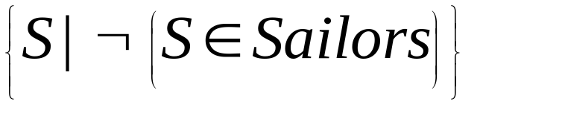
A Remark: Unsafe Queries
∃ syntactically correct calculus queries that have an infinite number of answers! Unsafe queries.
  e.g.,
  Solution???? Don’t do that!

Slide 14
Expressive Power
Expressive Power (Theorem due to Codd):
  Every query that can be expressed in relational algebra can be expressed as a safe query in relational calculus; the converse is also true.
Relational Completeness:
  Query language (e.g., SQL) can express every query that is expressible in relational algebra/calculus.
  (actually, SQL is more powerful, as we will see…)

Slide 15
Summary
Formal query languages — simple and powerful.
  Relational algebra is operational
    used as internal representation for query evaluation plans.
  Relational calculus is “declarative”
    query = “what you want”, not “how to compute it”
  Same expressive power
    --> relational completeness.
Several ways of expressing a given query
  a query optimizer should choose the most efficient version.

